Slide 1
Name : Dr. Anu Sharma
Qualification : M.A., Ph.D.
Designation : Guest Faculty Lecturer
Experience : 9 years

Slide 2
NATURE OF PHILOSOPHY
Class : B.A.-I (1st Sem.)
Period : 4th
MEANING OF PHILOSOPHY
The word “Philosophy” is made of two Greek words :
“Philo” which means Love
“Sophia” which means Knowledge
Therefore, the literal meaning of word is “Love of
Knowledge”
GENERAL MEANING OF PHILOSOPHY
If Philosophy means knowledge about man and the world, everybody posses such a knowledge, therefore, everybody has his own philosophy of life.

Slide 3
According to Plato, “Philosophy is the knowledge of the eternal and of the essential nature of things.
“Philosophy is a Collection of Science”
DIFFERENT STANDPOINTS OF PHILOSOPHY
Philosophy is a subject having various aspects and fields. Titus comes round to five main standpoints on the basis of which different definitions of Philosophy can be categorized. These five definitions or standpoints are discussed here.
- Philosophy is a method of reflective thinking and reasoned

Slide 4
According to Plato, “Philosophy is the knowledge of the eternal and of the essential nature of things.
“Philosophy is a Collection of Science”
- Philosophy is a personel attitude towards life & the Universe :- In this definition philosophy is defined as an attitude which a person has towards looking at the things & persons in life. But this attitude must be special in order to be called philosophical.
- Philosophy is a method of reflective thinking and reasoned inquiry:- In this philosophy is identified with a method of inquiry. It is yet to be learnt as to what a philosophical method of investigating the truth is.

Slide 5
Philosophy is an attempt to gain a view of the whole knowledge. This standpoint emphasizes the completeness of knowledge as the ultimate goal of philosophy and defines philosophy as a broad synthesis of all types of knowledge.
Philosophy is the logical analysis and the clarification of the meaning of words and concepts. This definition follows the point of view of the logical positivIsts who consider words and their meanings as the proper field of philosophy rather than knowledge. According to them, to achieve knowledge is not the concern of philosophy, because it is the sciences which do so. Philosophy should attempt at clarifications of concepts and the meanings of words.3
Philosophy is a group of problems as well as the theories about the solutions of these problems. This standpoint brings the issue of philosophical problems in the focus and lays emphasis on the philosophical systems which offer solutions to all such problems from their specific angle.

Slide 6
USES OF PHILOSOPHY
Philosophy inculcates in us the habit of thinking.
Philosophy yields new ideas.
Philosophy makes us more decisive.
Philosophy gives true freedom to man.
Philosophy is an essential part of higher education.
Philosophy is useful in the fields of sciences.
Philosophy is useful in the field of morality.
Philosophy is useful in the field of Art and Aesthetics.
Philosophy is useful in the yield of politics.

Slide 7
The Four Noble Truths & The Eightfold Path
Class : B.A.-I (2nd Sem.)
Period : 4th
The heart of Buddhist teaching is found in the Four Noble Truths. These truths are what Siddhartha Gautama became enlightened about when he became the "Buddha" or "enlightened one." These truths are shared by all the different groups, schools of thought and divisions within Buddhism.

Slide 8
The Four Noble Truths are:
1. The truth of suffering - life involves suffering or dissatisfaction. Even the most privileged lives involve suffering or dissatisfaction of some sort.
2. The truth of desire - suffering is caused by desire, specifically unenlightened desire
3. The truth of the cessation of desire - when unenlightened desire is ceased or eliminated from life, suffering ceases as well
4. The truth of the 8-fold path - desire is enlightened through right speech, right action, right livelihood, right effort, right mindfulness, right concentration, right understanding and right resolve

Slide 9
The Four Noble Truths support the common characterization of the Buddha as a doctor or healer. He assesses the life's condition, makes a diagnosis, and provides a prescription for the cure. Life involves suffering, even for those who lead privileged lives. Bad things happen, people get sick, loved ones die, things don't go as planned, and so on.
On closer inspection, the suffering we experience because of these things comes not so much from the things themselves, but from how we think about them and how we "desire" regarding them. Generally, we want them to be different from how they are, or to provide something they cannot provide. We want people to live forever - they won't. We want relationships to stay the same forever - they won't. We want our bodies to stay the way they were when we were at our best - they won't. We want everyone and everything we love to stay the same and live forever - they won't. Our ignorant, unenlightened desire drags us into these false cravings that can never be satisfied, so we suffer.
The prescription, according to the Buddha, is to cease this ignorant craving - to enlighten our desires. And the way to do this is to embark upon the eightfold path.

Slide 10
The eightfold path comprises the essence of the Buddhist spiritual path. It includes proper skills and behaviors, proper mental states and conditions, and proper aspirations and intentions. In short, it is the complete ethical, meditative and spiritual life of Buddhism.
The fact that the Four Noble Truths do not involve worshipping a deity or even revering the Buddha himself make them attractive to people from other religious traditions, as well as to people who are more secular or philosophical in their outlook. These truths and practices can be grafted onto those from other traditions fairly easily. Thus, we have people who call themselves "Zen Christians" or "Jew Boos" and who practice a blend of Buddhism with Christianity or Judaism.

Slide 11
DEFINITION AND USES OF LOGIC
Class : B.A.-II (3rd Sem.)
INTRODUCTION
Logic is one of the most important branches of Philosophy. First of all it is necessary to take up the word “Logic” and explain its meaning. This word is derived from a Greek word “Logike” which is further connected with “Logos”. It is used in two senses-
(1) Thought and (2) Word.
DEFINITION OF LOGIC
According to Thomson, “Logic is the science of la laws of thought.”
Aldrich says, “Logic is the art of reasoning.”
Whately defines, “Logic as the science and art of reasoning.”

Slide 12
Logic is a normative science of the laws of valid thought. We are able to explain the meanings of the various words used there in, these words are –
Science (2) Normative Science (3) Laws
(4) Validity (5) Thought
(1) SCIENCE
Logic is a science, but we must know the exact meaning of this word “sicence” in first instance and secondly it must also be cleared as to why logic is called a science. Therefore, science means knowledge.
Science is a systematic knowledge about a special subject-matter.
Science is methodical and classified knowledge.
Science is proved knowledge.
All sciences can be further divided into three categories-
Physical Sciences, Biological Sciences & Human Sciences

Slide 13
(2) NORMATIVE SCIENCE
On the basis of another consideration, all sciences can be divided into two kinds –
(a) Natural Sciences (b) Normative Sciences
Natural Sciences : All those sciences which describe the events of nature as such, are called natural sciences. They are based on facts. For example, Botany, Zoology and Psychology and Natural Sciences.
Normative Sciences : All those sciences which judge things according to a standard, are normative sciences. Natural sciences are concerned with “What is” while normative sciences are concerned with “What should be”.
There are many normative sciences, but below mentioned three out of them are Logic, Aesthetic and Ethics
Logic. Its standard is truth.
Aesthetics. Beauty is its standard.
Ethics. Its norm is goodness

Slide 14
(3) LAWS
Logic studies the laws of truth of thoughts. The following three types of laws operate in the three main fields-
(a) Natural Laws (b) Political Laws (c) Normative Laws
Natural Laws : A natural laws is the statement of the uniformity of natural events. For example, the laws of Gravitation in applicable on all things in
Political Laws : A political law is an order
There are many normative sciences, but below mentioned three out of them are Logic, Aesthetic and Ethics
Logic. Its standard is truth.
Aesthetics. Beauty is its standard.
Ethics. Its norm is goodness

Slide 15
(3) LAWS
Logic studies the laws of truth of thoughts. The following three types of laws operate in the three main fields-
Natural Laws
Political Laws
Normative Laws
(a) Natural Laws : A natural laws is the statement of the uniformity of natural events. For example, the laws of Gravitation in applicable on all things in the universe, on the Earth, on the Moon etc.
(b) Political Laws : A political law is an order from a parliament, king or a dictator to regulate the affairs of a society for its welfare. Political laws are of the nature of an order, therefore, their nature can be expressed as “Must” – a particular action must be done.”

Slide 16
Normative Laws : The laws which are imposed for the realisation of some ideal, are known as normative laws.
4. VALIDITY :
The meaning of “valid” is true or correct. How can we judge what is valid or what is invalid ?
The Principle of self-contradiction.
Principle of consistency with facts.
5. THOUGHT :
Logic is mainly concerned with thoughts. These three components of thought are -
Concept : A general idea of things is called concept.
Judgement : The process of relating two concepts is called jugement.
Reasoning : The process of passing from one or two judgements to a new judgement is known as reasoning or inference.

Slide 17
USES OF LOGIC
The study of Logic is a Part of True Education. Logic is the science of sciences. It is useful in everyday life. Logic can help us in explaining and demonstrating a truth.

Slide 18
SIKHISM – Sangat, Pangat and Sarbat Da Bhalla
Class : B.A.-II (4th Sem)
Sikhism is one of the prevailing religions in the north west of India. It is based on a way of the life and a philosophy of its own. Sikhism was born at a time when Hinduism and Hindu culture were in great peril due to the constant attacks on them by Muslim religion and culture.
Sikhism belongs to a reformatory movement which was led by saint-poets life Guru Nanka Dev Ji, Kabir, Ravidas, Namdev, etc. The philosophy of Guru Granth Sahib is Philosophy which is not derived form of the study of Vedas and Purans, but is based on the fresh experience of the highest order which has remained a perennial source of inspiration and guidance for the Indian people.

Slide 19
Five Stages of Spiritual Progress: We have seen that man is bound due to ignorance and his sense of Ego is born out his ignorance. At this stage man tends to have many evil tendencies, which lead to steadily moral and spiritual degradation in life, the real problem for man. How to bring these will tendencies under to control in order to avoid degradation in life is the real problem for man. According to Sikhism, the man who is attracted towards Divine Nam, is able to make progress towards a spiritual awakening and this process of spiritual uplift is graded through five stages.
The State of Dharma (Dharma Khand).
The Stage of Effort (Saram Khand)
The Stage of Knowledge (Gyankhand)
The Stage of Grace (Karam Khand)
The Stage of Truth (Sach Khand)

Slide 20
I. CONCEPT OF SANGAT
Sangat is a society or association of really good and saintly persons. In Sikh religion sangat means “Sadh Sangat”.
According to Guru Ramdas Ji Sadh Sangat, “Includes the company or sabha of those saints and seers in which Hari Kirtan is sung and heard.
II. FEATURES OF SANGAT
The main features of sadh sangat are given below-
Equality (2) Selflessness
(3) Sense of Togetherness (4) Peacefulness

Slide 21
CONCEPT OF PANGAT IN SIKHISM
Sangat and Pangat are the two most important institutions of Sikhism. Pangat means category, line and slowly it meant a line where every body will sit and eat the food together.
SARBAT DA BHALLA
In Sikh Dharam Ardas the “Chadh Di Kala” “Sarbat Da Bhalla”, “Mann Niva”.
Sarbat is totality of human beings having equality and brotherhood among themselves. The common meaning of ‘Sarbat’ is “all people” (Sarv log).

Slide 22
METAPHYSICS
Class : B.A.-III (Annual)
BRANCHES OF PHILOSOPHY
There are many smaller studies in the field of philosophy which can be called philosophical sciences. Most of them are becoming independent of philosophy on the basis of their progress such as Psychology, Ethics. Aesthetics etc. But they are still called the branches of Philosophy. One such science which cannot be separated from philosophy is called Metaphysics. All other branches of Philosophy are directly related with it and Metaphysics is what is real philosophy. The various branches of philosophy in respect of their relationship with Metaphysics are :

Slide 23
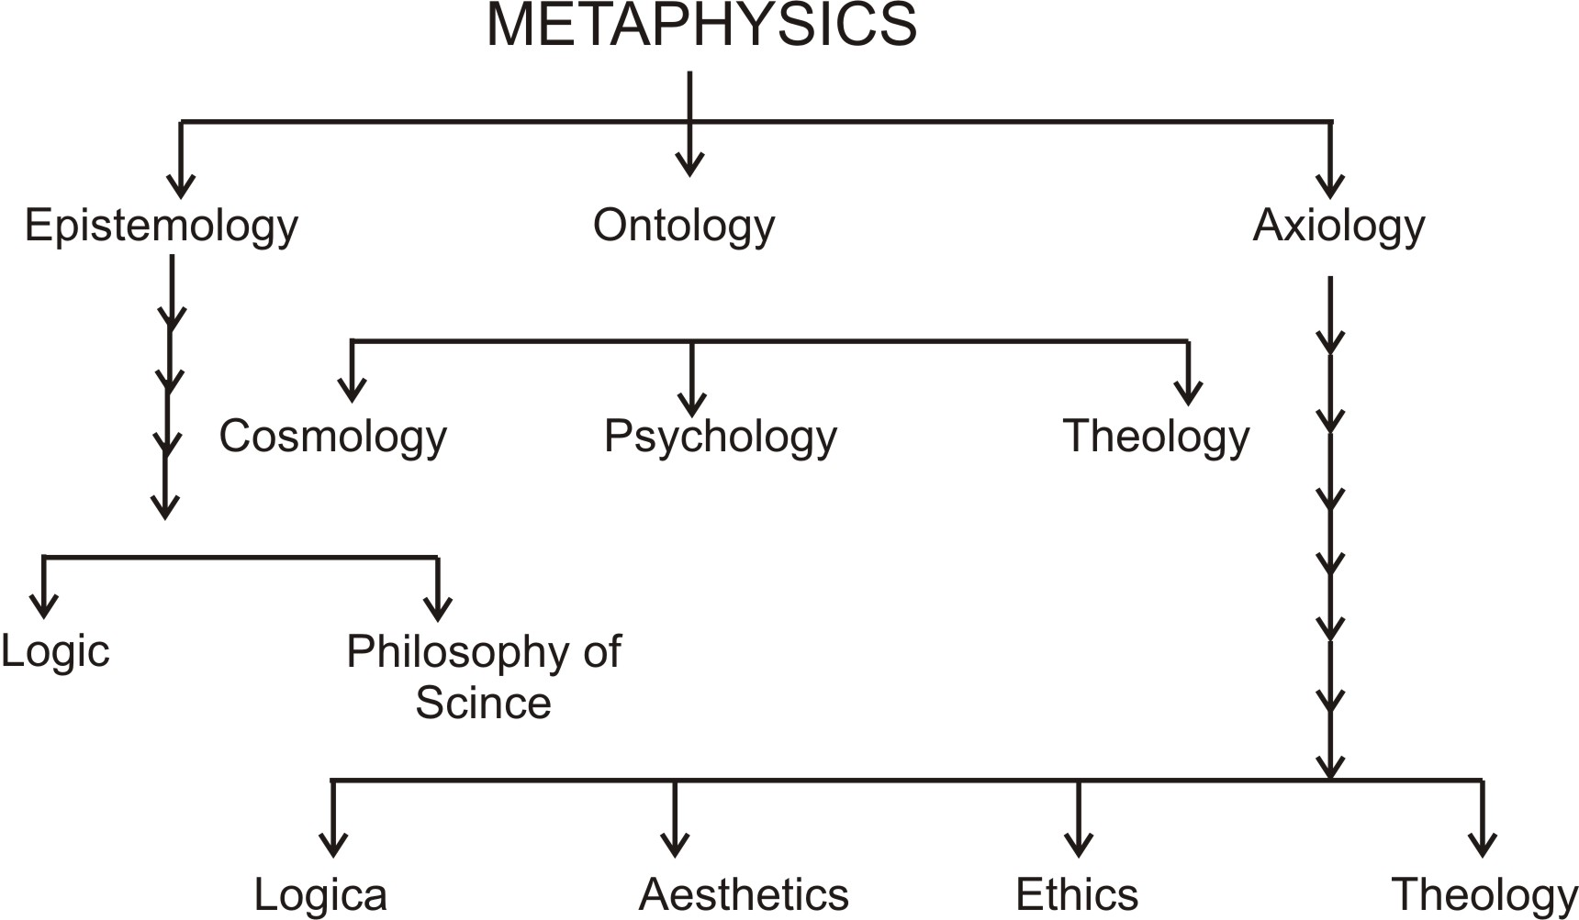
WHAT IS METAPHYSICS ?
Metaphysics is considered to the most fundamental of all the philosophical sciences. It is often equated with philosophy so that philosophy is Metaphysics and Metaphysics is philosophy.

Slide 24
THREE BRANCHES OF METAPHYSICS
It has face atleast three problems which are fundamental to the inquiry into reality -
How to know the reality ? What is truth ?
What is the reality ?
What is the value of reality ?
The following three studies undertake to investigate and solve the above problems respectively -
Epistemology – the science of knowledge
Ontology – the science of existence
Axiology – the science of values
What are the sources f knowledge ?
What is the nature of knowledge ?
How to determine truth ?

Slide 25
ONTOLOGY
It is the main branch of Metaphysics which studies the nature of “Being” or “Existence”.
Discuss these theories here -
Monism
Materialism
Spiritualism
Neutral Monism
Dualism
Pluralism

Slide 26
BRANCHES OF ONTOLOGY
Ontology is the study of existence which consists of the universe, the self of man and God.
Cosmology. It is science of the entire universe which is also called “Cosmos.
Psychology. It is a science of self.
Theology. It is a branch of ontology or philosophy.
NOTION OF SUBSTANCE IN METAPHYSICS
Ontology is the study of existence which consists of the universe, the self of man and God.
Substance
Attribute
Modes
-- Axiology. Axiology is science of value.

Slide 27
AESTHETICS
Class : B.A.-III (Annual)
MEANING AND NATURE OF AESTHETICS
Aesthics is the study of Beauty. It is an important branch of Axiology. Beauty itself is a very important value of human life.
THE NATURE OF AESTHETIC EXPERIENCE
We have found that Aesthetics moves within the limits of aesthetic experience. If we analyse aesthetic experience, we find that atleast three elements are present in it, which can be stated as under :
1. Perception. 2. Emotion 3. Joy

Slide 28
Perception : Aesthetic experience depends upon perception. Just as a person get the sanctions of colour, sound, smell, taste and touch, the same happens in the aesthetic experience too, because a beautiful object is also an object like others to be known by sensory experience. The dependence of aesthetic experience on form, shape, colour and sound is more than otherwise.
Emotion : There is an important difference between sensory experience and aesthetics experience. This is known as aesthetic emotion which is different from other emotions too.
Joy : Many types of emotions can be aroused in the mind, but aesthetic emotion is distinguished from them in the respect that even if pleasurable feelings attend on the satisfaction of other emotions. It is on the basis of aesthetic joy which one gets on seeing an object of beauty, that aesthetic emotion stands distinguished from other emotions, an object that can yield such a joy, it is beautiful.

Slide 29
NATURE OF BEAUTY
Beauty is the sole subject-matter of Aesthetics. The most fundamental question remains as to what is beauty ?
According to Plato, Beauty is a super-sensible essence.
F.H. Bradly defines Beauty as an image of infinity.
According to the old tradition, Beauty and Art must be one. Whatever is beautiful, is Art and whatever is artful, is Beauty at the same time. If something is not beautiful, it is not Art also. But the modern tradition goes to prove that there is distinction between Beauty and Art, because Art sometimes expresses something ugly and horrible. An artist wishes to present objects of art as they are, may they be ugly.

Slide 30
HAVE A GOOD DAY

